Slide 1
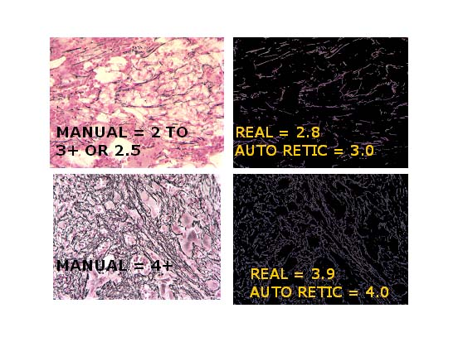
TISSUEFIBROSIS SCORE
Converts a tissue reticulin stain into score, 0 , 1, 2, 3 ( or negative, 2,3, 4)

